Slide 1
HAND GESTURE RECOGNITION
SONIYA M
KGISL INSTITUTE OF TECHNOLOGY
711721243103
3/21/2024 Annual Review

Slide 2
PROJECT TITLE
3/21/2024 Annual Review

Slide 3


AGENDA
Problem Statement
Project Overview
Who are the end users
Solution and its value propostion
Solution
Modelling
Results
3/21/2024 Annual Review

Slide 4

PROBLEM STATEMENT
In today's digital age, the interaction between humans and computers is often hindered by traditional input methods, such as keyboards and mice, which can be unintuitive.
Hand gesture recognition presents a promising solution to this problem by allowing users to communicate with devices using natural hand movements.
Therefore, there is a pressing need to develop a robust hand gesture recognition system that can accurately and efficiently interpret a wide range of hand gestures in real-time, enabling more seamless and intuitive human-computer interaction across various applications and settings.
3/21/2024 Annual Review

Slide 5

PROJECT OVERVIEW
The Hand Gesture Recognition System aims to develop a sophisticated solution that enables users to interact with computers and devices using natural hand movements.
Dataset Collection: Acquire diverse datasets of hand gestures representing different movements and expressions to train and validate the recognition system.
Preprocessing: Prepare the collected datasets through techniques such as noise reduction, normalization, and feature extraction to enhance the quality and relevance of the data.
Gesture Recognition Algorithms: Implement and optimize state-of-the-art machine learning and computer vision algorithms, such as Convolutional Neural Networks (CNNs) and Recurrent Neural Networks (RNNs), for accurate and efficient recognition of hand gestures.
Real-time Processing: Design and develop a robust pipeline for real-time processing of hand gesture data, ensuring low latency and seamless interaction between users and devices.
Evaluation Metrics: Define and utilize appropriate evaluation metrics, such as accuracy, latency, and robustness, to assess the performance of the hand gesture recognition system under different conditions and scenarios.
3/21/2024 Annual Review

Slide 6

WHO ARE THE END USERS?
The end users of the hand gesture recognition system can vary depending on the specific application and context in which the system is deployed.Some potential end users include:
Individuals with Disabilities: People with mobility impairments or other disabilities may benefit from hand gesture recognition as an alternative input method for accessing computers, communication devices, or assistive technologies.
General Consumers: Everyday consumers may use hand gesture recognition in smart home devices, smartphones, or public interactive displays for tasks such as controlling music playback, navigating menus, or making gestures-based payments.
3/21/2024 Annual Review

Slide 7

YOUR SOLUTION AND ITS VALUE PROPOSITION
The Hand Gesture Recognition System is a cutting-edge technology that enables users to interact seamlessly with computers and devices through natural hand movements.
Value Proposition:
Enhanced User Experience: Our system offers a more intuitive and engaging user experience by allowing users to interact with technology using natural gestures, eliminating the need for traditional input devices like keyboards or controllers.
Increased Efficiency: By enabling users to perform tasks and commands through hand gestures, our system streamlines interaction workflows, reducing the time and effort required to execute actions in applications such as gaming, virtual reality, or computer-aided design.
Accessibility and Inclusivity: Our technology opens up new possibilities for individuals with disabilities, providing an alternative input method that can be tailored to their specific needs and abilities, thereby promoting inclusivity and accessibility in digital environments.
3/21/2024 Annual Review

Slide 8

THE WOW IN YOUR SOLUTION
The wow factor in our Hand Gesture Recognition System lies in its seamless integration of cutting-edge technology with everyday interactions, fundamentally transforming how users engage with computers and devices.
By harnessing the power of advanced computer vision and machine learning algorithms, our system enables users to control and interact with technology effortlessly through intuitive hand gestures.
Whether it's navigating virtual worlds in gaming, manipulating 3D models in design, or communicating in sign language, our solution offers a truly immersive and inclusive user experience that transcends traditional input methods.
With its versatility, accuracy, and potential for revolutionizing human-computer interaction, our Hand Gesture Recognition System is not just a step forward—it's a leap into the future of computing.
3/21/2024 Annual Review

Slide 9
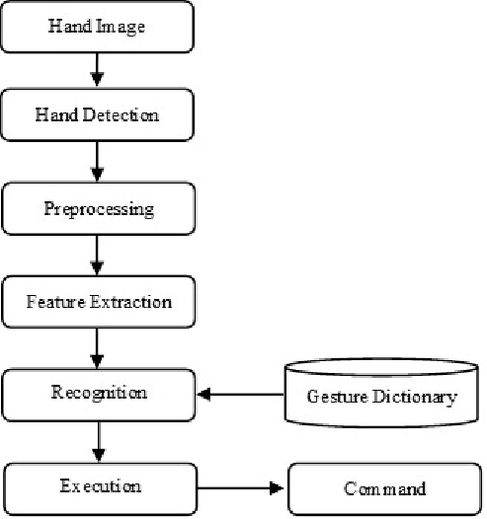
MODELLING
3/21/2024 Annual Review

Slide 10
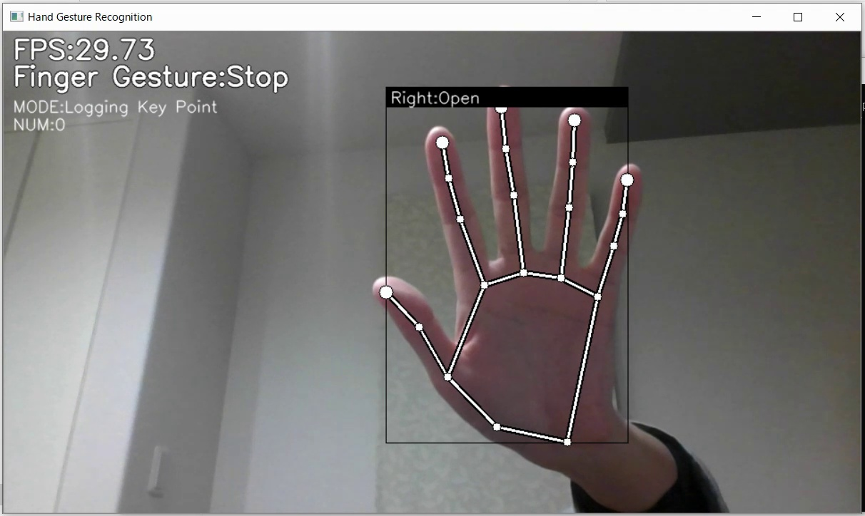
RESULTS
Demo Link
3/21/2024 Annual Review

